Slide 1
Book subscription analysis: Analyzing Customer Behavior
By: Fadeke Babatunde
DataLab Analytics Internship Program, Jan. 2023

Slide 2
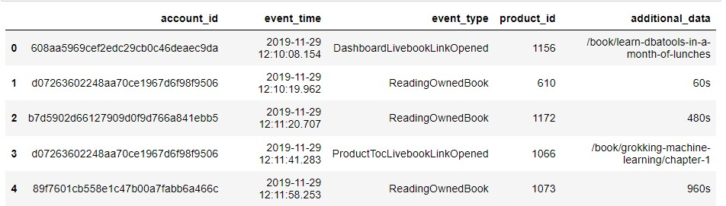
Summary 0f Features for the Book Subscription Data using Python for analysis.

Slide 3
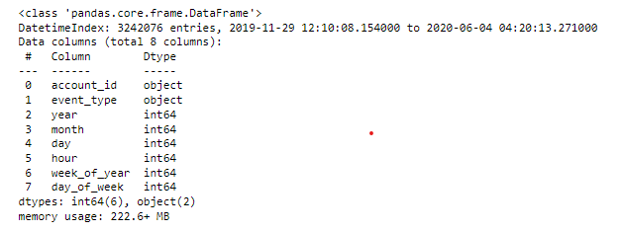
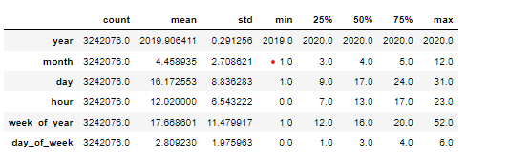
Data Preparation and Analysis
The dataset has 3242076 rows and 10 columns. Converted the event time from object using date time.
The event time ranges from 2019-11-29 12:10 to 2020-06-04 04:20
I dropped rows containing NaN values which is to scale down the data due to my computing resources (“additional data”) and also redundant features: (“product_id”)
Event time was broken down into features into year, month, day, hour and weeks for better analysis

Slide 4
OBJECTIVES
• What events are most common?
• What events are least common?
• Get the account id with the highest number of events.
• Get the account id with the least number of events.
• How many times events occurred based on different times of the day

Slide 5
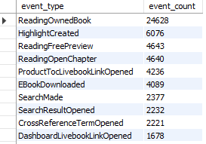
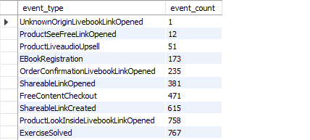
Most common and Least common Event Type on my SQL query.

Slide 6
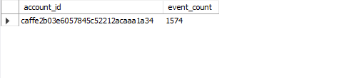
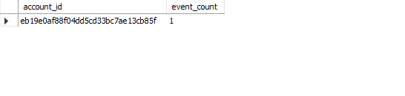
ACCOUNT_ID OF THE HIGHEST AND LEAST NUMBER OF EVENTS

Slide 7
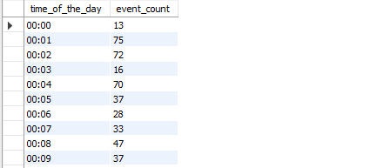
Number of Times events occurred based on different times of the day

Slide 8
Brief Overview of SQL queries
Most common type of event of the subscribers is ReadingOwnedBook with 24,628 count
The least common type of event of the subscribers is UnknownOriginLivebookLinkOpened with 1 count
The account id with the highest number of events is caffe2b03e6057845c52212acaaa1a34
The account id with the least number of events is eb19e0af88f04dd5cd33bc7ae13cb85f

Slide 9
Recommendations
More features should be added to the analysis(ReadOwnedBook) which can help us understand customers,behavior E.g ,Title , author,genre.
Since 65% of customers are more likely to read owned books ,FirstLiveBook Access and FirstManningAccess,the organisation should improving the dashboard and invest more in maketing more in marketing and advertising of Books to get more traffic on the platform.

